Slide 1

Diabetes Risk Analysis
Machine Learning & Data Visualization
Project Viva Presentation
Machine Learning

Slide 2
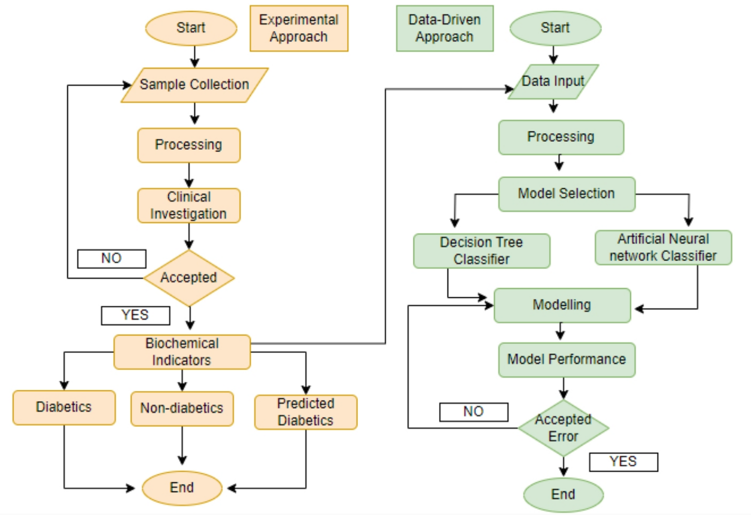
Project Objective
Predict diabetes risk using health data
Use ML models and visual analytics

Slide 3
Dataset Overview
Age, BMI, Glucose, Blood Pressure, Insulin,
Target: Diabetes Outcome
Glucose
BMI
Age
DiabetesPedigreeFunction
BloodPressure
Insulin
Class 0
SKinThickness
Class 1
0.00
0.05
0.10
0.15
0.20
0.25
0.30
Mean (|SHAP value|) (average impact on mode output magnietiuc

Slide 4
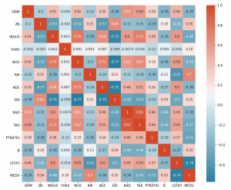
Correlation Heatmap
Shows relationship between features
Helps in feature selection

Slide 5
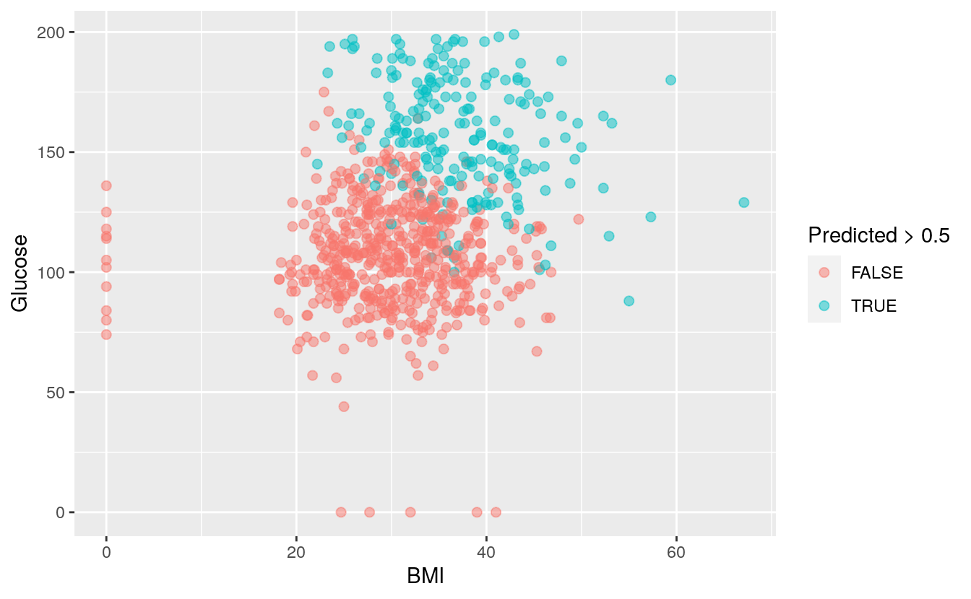
BMI vs Glucose Graph
Visual risk zones for diabetes
Higher BMI & glucose = higher risk

Slide 6
Model Comparison
Logistic Regression, SVM, Random Forest, Gradient Boosting
Best model selected by accuracy
Logistic Regression
71.25%
RandomForest
67.50%
Gradient Boosting
61.88%
SVM
64.38%
0
10
20
30
40
50
60
70

Slide 7
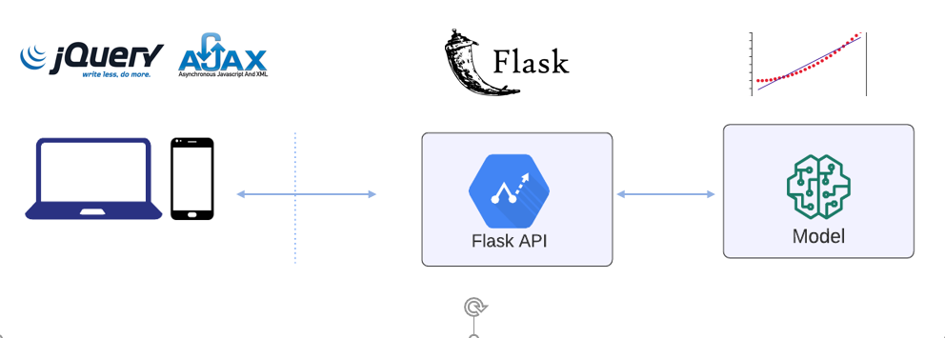
System Architecture
Flask Web App
ML Model + Visual Graphs

Slide 8
Advantages
Easy interpretation
Modern UI
Explainable ML

Slide 9
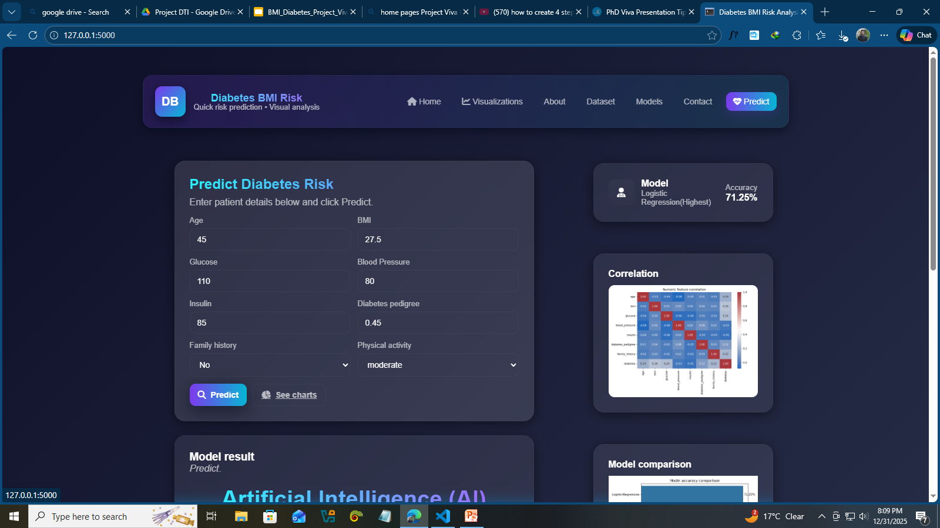
Future Scope
More data
Advanced ML models
Interactive dashboards

Slide 10
Conclusion
ML + Visualization improves healthcare insights
Thank You

